Slide 1
Variance
3962 scarlet oak court
board of adjustment
December 4, 2025

Slide 2
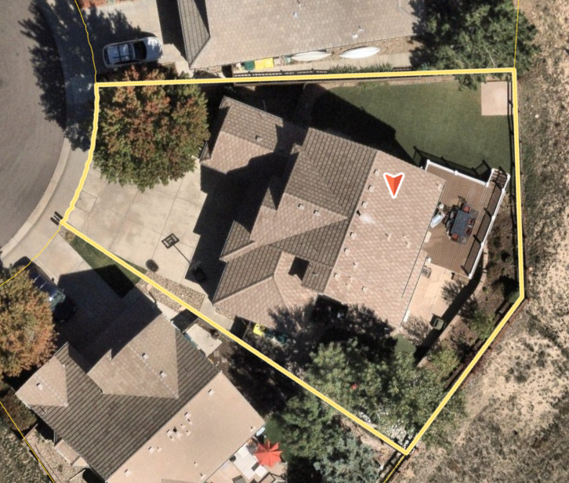
2

Slide 3
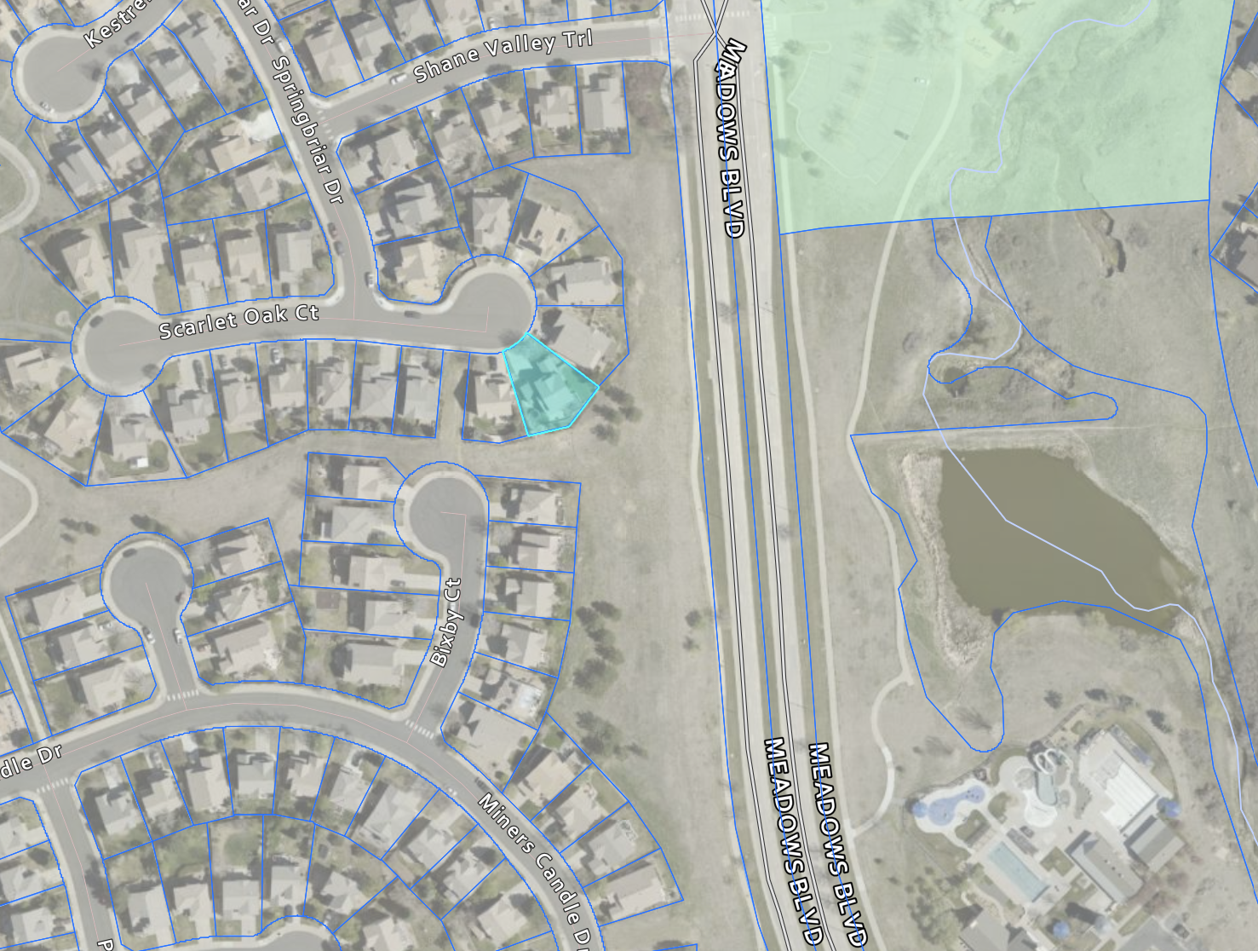

Slide 4
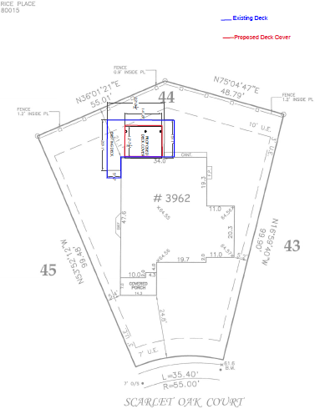
5

Slide 5
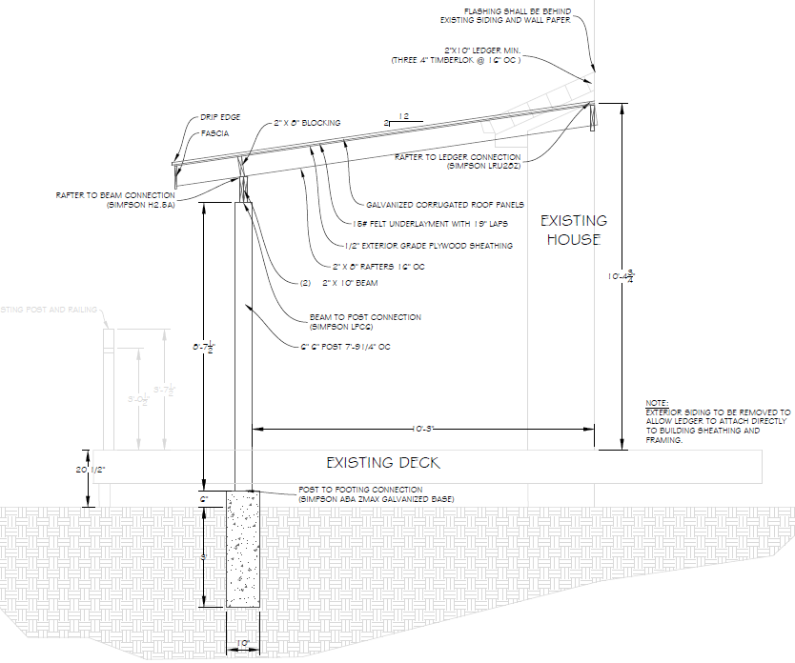
3

Slide 6
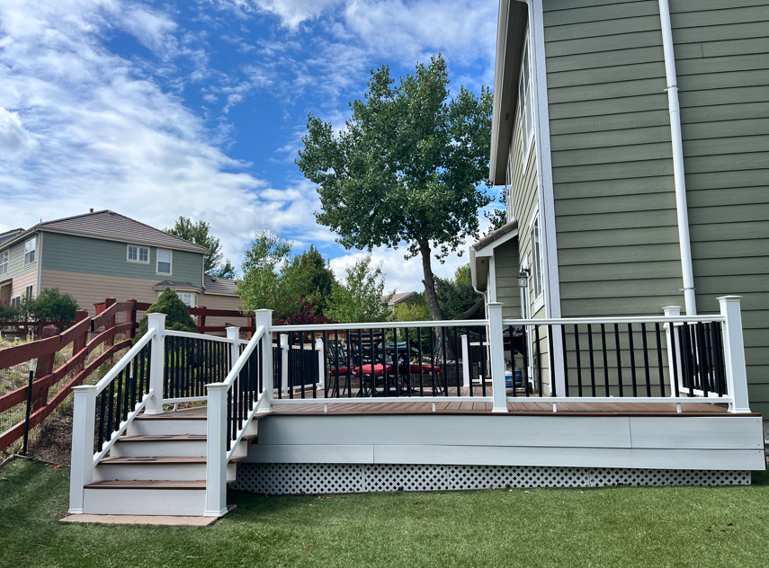

Slide 7
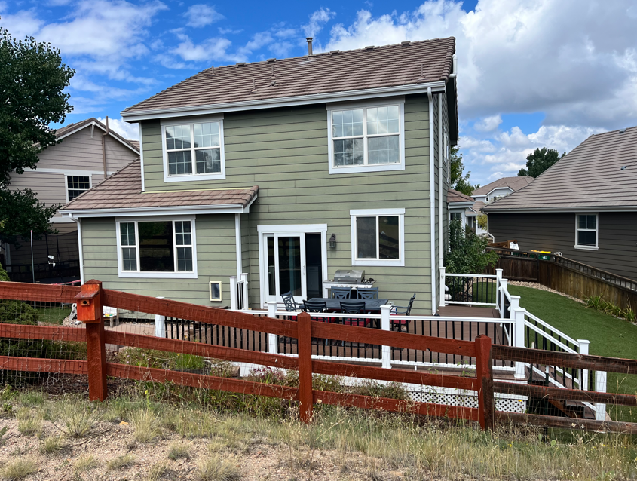

Slide 8
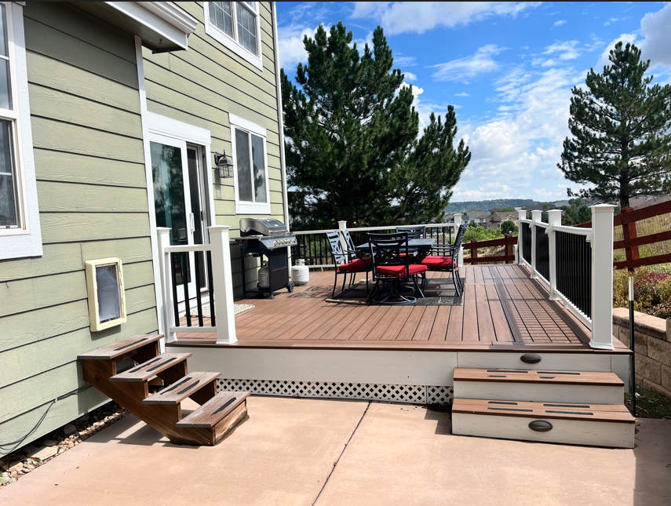

Slide 9
Zoning:
LOT 44 Block 1 the MEADOWS 11th FLG
REAR SETBACK: 20’
Town of castle rock
11
Excellence · Dedication · Service

Slide 10
Variance request
To encroach 10’ into the required 20’ FRONT SETBACK for a DECK COVER.
Town of castle rock
12
Excellence · Dedication · Service

Slide 11
Staff findings
Staff recommends approval of this project based on:
The lot is irregular in shape
The lot backs to open space and Meadows Blvd
HOA has approved the request for the previously built deck and deck cover
No objection from neighbors
CORE has approved the existing previously constructed deck and stairs located in the rear 10’ utility easement
13

Slide 12
Thank you
Town of castle rock
Excellence · Dedication · Service
Notes:
Thank you.

Slide 13
Motion options
In accordance with criteria as stated in the Town of Castle Rock Municipal Code Section 17.06.020 BOARD OF ADJUSTMENT:
Option 1
I MOVE THAT THE BOARD OF ADJUSTMENT APPROVE Brian and Megan Peterson’s request for approval of a variance from the minimum required rear setbacks to construct a deck cover over an existing deck on an existing single-family residence, as shown in the attached plot plan, in the PD zone; based upon:
Option 2
I MOVE THAT THE BOARD OF ADJUSTMENT DENY Brian and Megan Peterson’s request for approval of a variance from the minimum required rear setbacks to construct a deck cover over an existing single-family residence, as shown in the attached plot plan, in the PD zone based on the required hardship has not been demonstrated.
Option 3
I MOVE THAT THE BOARD OF ADJUSTMENT CONTINUE THE PUBLIC HEARING TO THE NEXT REGULAR MEETING ON JANUARY 15, 2025.
15

